Slide 1

Who’s the Boss?
Honoring God at Home and at Work
6:1 – 9
Week 27
7 September 2022

Slide 2

Ephesians ch6 overview
The final chapter begins with what might be called an exhortation to “walk in familial harmony.” Children are told to obey their parents, while fathers are instructed not to provoke their children to wrath but bring them up in the Lord’s nurture and admonition (1-4).
Since many households in the first century A. D. contained servants and slaves, commands are also given on their duties and that of their masters (5-9).

Slide 3
Ephesians ch6 overview
The last major section of this epistle is a call to “walk in victory,” with a charge to stand strong in the power of the Lord’s might. Additionally, to be able to withstand the wiles of the devil and spiritual wickedness in heavenly places, Christians are admonished to adorn themselves with the whole armor of God (10-13).
This armor includes truth, righteousness, the gospel, faith, salvation, and the Word of God. Standing strong also requires fervent and watchful prayer, not just for one’s self, but for all Christians. Even Paul solicits the Ephesians’ prayers that he might be bold as an ambassador in chains as he makes known the mystery of the gospel (14-20).

Slide 4
Ephesians ch6 overview
A brief explanation is then given concerning Tychicus, who was sent to let them know how Paul is doing. The epistle then concludes with a prayer for peace to the brethren, love with faith, and grace for all who love the Lord Jesus Christ in all sincerity (21-24).

Slide 5

“Who’s the Boss?”

Slide 6
Ephesians 6:1 – 9
From the intricate and priceless tapestry of marriage, Paul moves on to apply his principles of Spirit-filled submission to two other challenging relationships: parenthood (6:1-4) and employment (6:5-9).
Though these two relationships exist in different realms of life, the principles of submission and responsible leadership are the same as those Paul dealt with in the previous section on marriage. In fact, we can apply these principles of harmony to all kinds of relationships—in the church, in society, in government, and in any relationship that may need attention. Humility and grace always seem to be in short supply.

Slide 7
Ephesians 6:1 – 4
¹Children, obey your parents in the Lord, for this is right. ²“Honor your father and mother”—which is the first commandment with a promise— ³“so that it may go well with you and that you may enjoy long life on the earth.” ⁴Fathers, do not exasperate [provoke] your children; instead, bring them up in the training and instruction of the Lord.

Slide 8
Ephesians 6:1 – 4
Paul begins by addressing children who are responsible for obeying their parents “in the Lord” (6:1). On the surface, it may appear that Paul is limiting the scope of children’s obedience, either (1) to parents who are Christians (that is, “in the Lord”) or (2) to parents who are behaving in a godly manner (that is, walking “in the Lord”).
The parallel passage in Colossians 3:20, however, helps us better understand Paul’s thought here: “Children, be obedient to your parents in all things, for this is well-pleasing to the Lord.”
So in Ephesians 6:1 the phrase “in the Lord” qualifies the verb “obey,” explaining that children must be subject to their parents as their way of being subject to the Lord.

Slide 9


Slide 10
Ephesians 6:1 – 4
Jesus Himself, the very Son of God, through whom the Father created all things (John 1:1-3), “continued in subjection: to His earthly parents, Joseph and Mary (Luke 2:51). Therefore, nobody can say that submission and obedience imply inequality or inferiority. Rather, voluntarily accepting a role of subjection leads to harmony and blessing.
Paul says as much when he reiterates the fifth commandment God gave Moses in the Law (Exod 20:12)—the first of the Ten Commandments with a specific promise (6:2). In his quotation, though, Paul makes a minor change to apply the text more generally to his readers’ new situation. The original commandment offered blessing in the Promise Land (Israel) for obedient children.

Slide 11
Ephesians 6:1 – 4
“Honor your father and your mother, as the Lord your God has commanded you, so that you may live long and that it may go well with you in the land the Lord your God is giving you” (Deut 5:16).
But Paul’s readers—mostly Gentile believers in Ephesus—were not the recipients of the Law of Moses, were not obligated to its numerous mandates.
So Paul leaves out the final clause of the commandment, generalizing the theological principle that applies even to Christians today: Obedience to parents brings with it a blessing in this world, just as it brought with it a blessing to the Israelite children. Paul says that submission to parents will lead to wellness and long life (6:3).

Slide 12


Slide 13
Ephesians 6:1 – 4
Of course, this isn’t a guarantee that those who honor their fathers and mothers will never get sick and will live to be a hundred! Rather, Paul is presenting proverbial wisdom: Children who learn from the wisdom of their parents will avoid all sorts of destructive hardships and even deadly consequences.
In fact, the same kind of promise is described in Proverbs 1 for those who heed the call of wisdom: They will “live securely and will be at ease from the dread of evil” (Prov 1:33).
Paul’s practical point is clear. In God’s ordering of the family, He has placed parents in authority over children because the young need the wisdom, guidance, and protection only loving parents can provide.

Slide 14
Ephesians 6:1 – 4
The Christian home is meant to be a school for life lessons. Parents are meant to be teachers of truth and trainers in righteousness. They are to live the gospel of Christ and walk in grace. Children must therefore honor and obey their parents, not grudgingly, not merely outwardly, but with respect and love.
Yet in order to have a harmonious family characterized by mutual submission (5:21), parents have a vital responsibility too. The command that children obey their parents does not give mom and dad divine sanction for harsh, unloving, tyrannical, ironfisted rule.
Rather, Paul turns to the head of the home, the father, and warns him, “Do not provoke your children to anger (6:4).

Slide 15


Slide 16
Ephesians 6:1 – 4
The idea is that through his overbearing actions a father can push a child over the edge, not only failing to impart wisdom but actually pushing a child away from wisdom! What are some of the things that “provoke” children toward anger, resentment, and bitterness?
unreasonable demands for perfection
constant nagging over minor infractions
lack of encouragement and affirmation
harsh, unloving rebukes or cruelty
public embarrassment – verbal or physical abuse
inconsistent discipline
showing favoritism for one child over another
overprotective hovering that stifles growth

Slide 17
Ephesians 6:1 – 4
Instead of provoking, which brings children down, Paul says, “bring them up in the discipline and instruction of the Lord” (6:4). This includes providing for their physical, mental, emotional, and spiritual needs. It means providing proper, balanced, loving discipline when the child goes astray . . . And it means instructing the child positively in the right way.
Speaking of which, a good sense of humor can add great joy in the home. Happiness is often a sign of healthy relationships. Wise are those parents who bring laughter and fun into their family work projects, mealtime discussions, and everyday conversations.

Slide 18
Ephesians 6:5 – 9
⁵Slaves, obey your earthly masters with respect and fear, and with sincerity of heart, just as you would obey Christ. ⁶Obey them not only to win their favor when their eye is on you, but as slaves of Christ, doing the will of God from your heart. ⁷Serve wholeheartedly, as if you were serving the Lord, not people, ⁸because you know that the Lord will reward each one for whatever good they do, whether they are slave or free.

Slide 19
Ephesians 6:5 – 9
Paul now moves from the proper functioning of the home into another realm of the social order, slaves and masters. Here Swindoll dispels a few misconceptions about Paul’s original historical context.
FIRST – Paul is not departing from his discussion of family relationships. In the first century, many slaves were akin to “domestic servant” – actual members of a household; therefore, the master-and-slave relationship was logically associated with Paul’s discussion of marriage and parenting. To leave this relationship out of his discussion would be to ignore a common feature of the first-century household.

Slide 20
Ephesians 6:5 – 9
SECOND – by describing how Christian masters and slaves were to relate to one another, Paul was not, in fact, explicitly supporting the institution of slavery. Paul clearly notes that if a slave can gain freedom, this is to be preferred. And those who are free should not submit themselves to slavery. We see here the principle that slavery is a tolerable—but not ideal—situation.
Swindoll quotes John MacArthur > “New Testament teaching does not focus on reforming and restructuring human systems. The issue is always the human heart—which when wicked will corrupt the best of systems and when righteous will improve the worst. If men’s sinful hearts are not changed, they will find ways to oppress others regardless of whether or not there is actual slavery.”

Slide 21
Ephesians 6:5 – 9
THIRD – slavery in Paul’s world was not the same kind of institution that it was in the nineteenth century. Slaves in the first century were more a socioeconomic class than a racial class of imprisoned forced labor.
The reason most Christians could tolerate the institution of slavery in the first century was because in many cases it was tolerable. Unlike the brutal race-based slavery in later history, first-century slavery did not necessarily strip humans of their dignity or reduce them to mere pieces of disposable property. In some homes, slaves enjoyed considerable freedom, rights, and responsibilities. Some slaves worked as tutors, nannies, cooks, or gardeners.

Slide 22
Ephesians 6:5 – 9
Today, thankfully, most societies have banned slavery and diligently seek to avoid slave-like conditions. So for us, Paul’s words to slaves and masters can be best applied to those in permanent employee-employer relationships. While the institutions of ancient slavery and modern employment do have fundamental differences, the practical principles governing both institutions are similar.
Whether you are a contract worker, an hourly employee, a manager, or a business owner, Paul’s principle of submission applies to you (5:21). Paul talked to the slaves and masters of his day in the same way he would address employees and employers today.

Slide 23
Ephesians 6:5 – 9
The way we conduct ourselves during the dozens of hours we spend at work each week is just as important for the promotion of the gospel as the few hours we spend each week at church.
In 6:5, we see the first element of a godly work ethic—obedience. It’s the same responsibility children have toward their parents (6:1). As workers obligated to carry out the instructions of our bosses, we owe them the same honor, respect, and submission that we owed to our parents when they were raising us.
In fact, our submission should be with “fear and trembling,” with a sincere heart, and with the same kind of service we would show towards the Lord Himself.

Slide 24


Slide 25
Ephesians 6:5 – 9
Yes, the Lord Jesus is our heavenly Master, and we ultimately worship and serve Him alone; yet by giving one hundred percent to our “masters according to the flesh” (6:5), we are actually serving the Lord. Why? Because Paul said elsewhere, “whatever you do, do all to the glory of God” (1Cor 10:31).
Basically, then, we are to carry out our assignments with honor, humility, and honesty. We’re to work hard at our jobs and treat our employers with respect. But what about those times when your boss seems undeserving of respect? Or when your task seems unnecessary, ill-planned, or even pointless? How about when you believe you could do a better job running the organization?

Slide 26
Ephesians 6:5 – 9
The answer is the same. Obey. Submit. Show respect. Unless an employer tells us to do something illegal, unethical, or contrary to Christ’s explicit commands, we are responsible for carrying out the assignments given to us.
Paul describes this perspective in Ephesians 6:6-7. We are to avoid “eye service,” which means serving “with a view to impressing others. That is, “putting on appearances” or doing things “just for show.” This kind of work ethic leads to the old adage, “When the cat’s away, the mice will play.”
Paul unequivocally excludes this kind of behavior for Christians. We must not strive to be “men-pleasers,” focusing on appearance only, but authentic servants of Christ even in the realm of secular work.

Slide 27
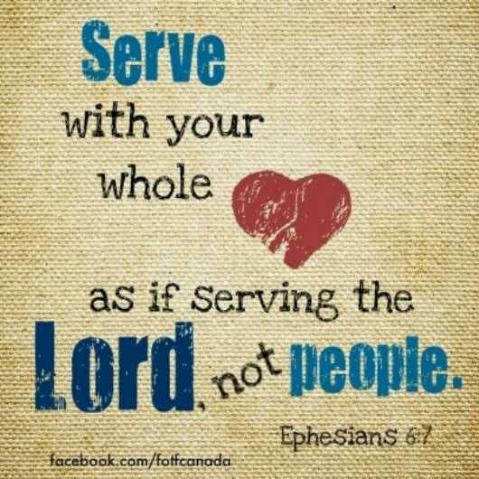

Slide 28
Ephesians 6:5 – 9
When the earthly boss is gone, we must never forget that our heavenly Master is always with us, and it is to Him, not to other human beings, that we must ultimately give account for our lives.
As employees, we receive a paycheck for the work we do. But that reward is temporary and soon spent. Paul promises, however, that God will reward us eternally for our faithful service to our earthly bosses (6:8).
Your employer may not appreciate most things you do. He or she may not even know your name. But God knows you better than you know yourself, and He will never forget your diligent, wholehearted efforts in service of Him.

Slide 29
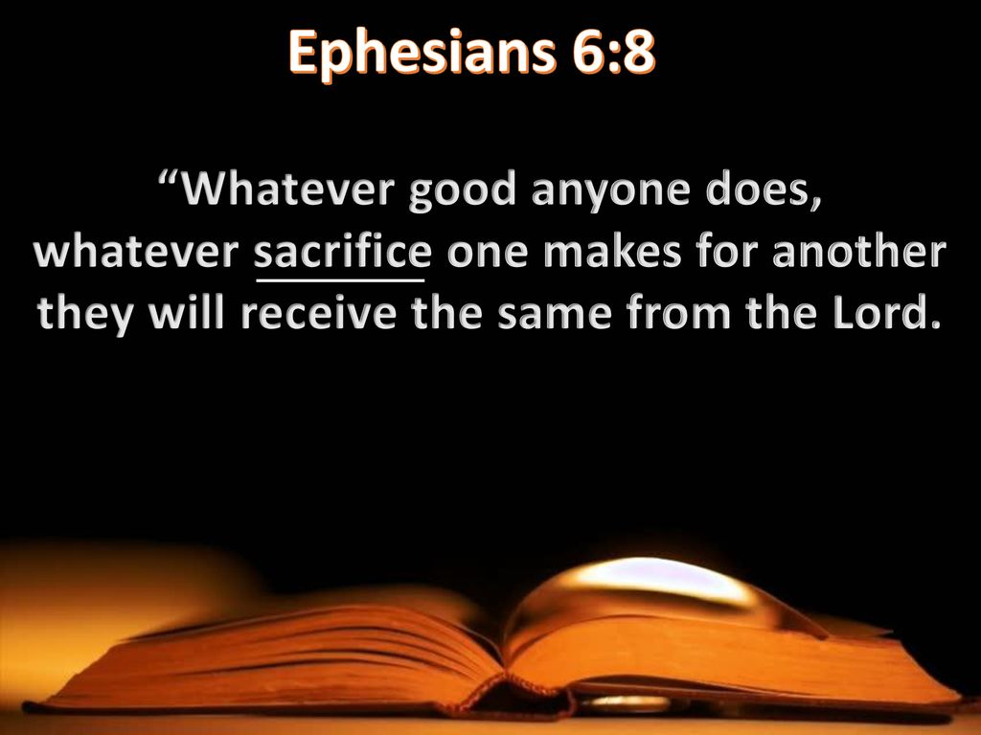

Slide 30
Ephesians 6:5 – 9
Just as Paul addressed husbands and fathers as those responsible for leadership in marriage and the family, he also addresses master—equivalent to our modern employers—as leaders of their households (6:9).
Note that Paul begins by saying, “Treat them the same way.” That is, bosses are to treat their employees with the same spirit with which workers are to treat their bosses, namely, with honor and respect, as ministering to the Lord.
Why is it so important to treat employees with respect? Because with God “there is no favoritism” or partiality (6:9). Employers and employees are equal in God’s eyes. Both will someday stand before God to account for their attitudes and actions.

Slide 31
Ephesians 6:5 – 9
Never forget: The world doesn’t watch our behavior at church on Sundays or in Bible studies on weeknights. They watch us at home. They see us at work. They notice how we treat our parents. They pay attention to how we raise our children. They notice when we labor at our occupations with integrity.
And they appreciate the qualities of a thoughtful, fair, and generous boss. In all of these realms—marriage, family, and work—we are to be subject to one another in the fear of Christ (5:21). In this way we will demonstrate to all people that not only are we saved by the blood of Jesus Christ, but we are also living lives under the control of the Holy Spirit.

Slide 32
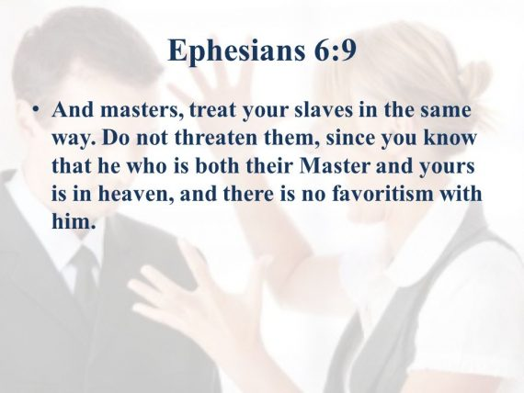

Slide 33



Slide 34
NEXT CLASS – 14 September 2022
Book of Ephesians
Before next class, read the below verses in the NIV and in one other versions of the Bible, i.e., NKJV, NRSV, KJV, CEV, etc …
Chapter 6:10 – 13
“Standing Strong against Satanic Schemes”

